Slide 1

NYPD Shooting Incident Analysis
Anastasiia Stukova
2025.01.28

Slide 2
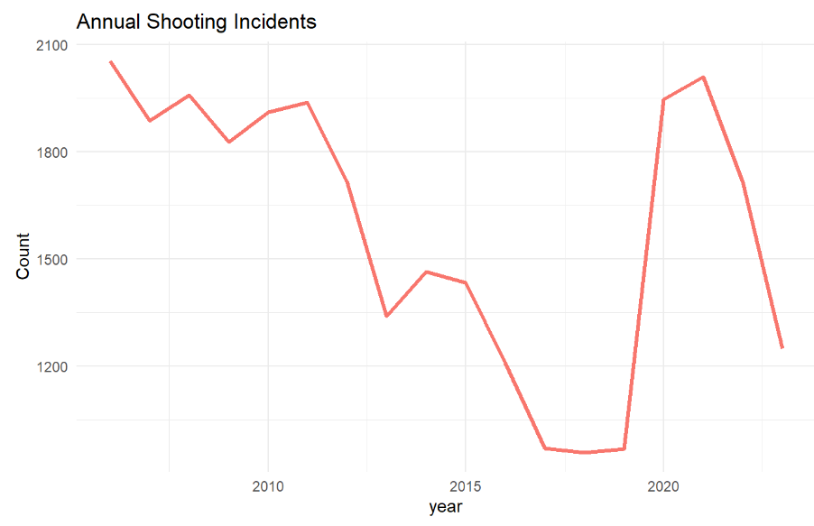
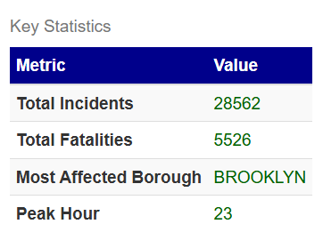
Total Incidents Breakdown
Annual Incident Count
In the year 2025, New York City
reported a total of 28,562
shooting incidents –
statistics of human stories and tragedies.

Slide 3
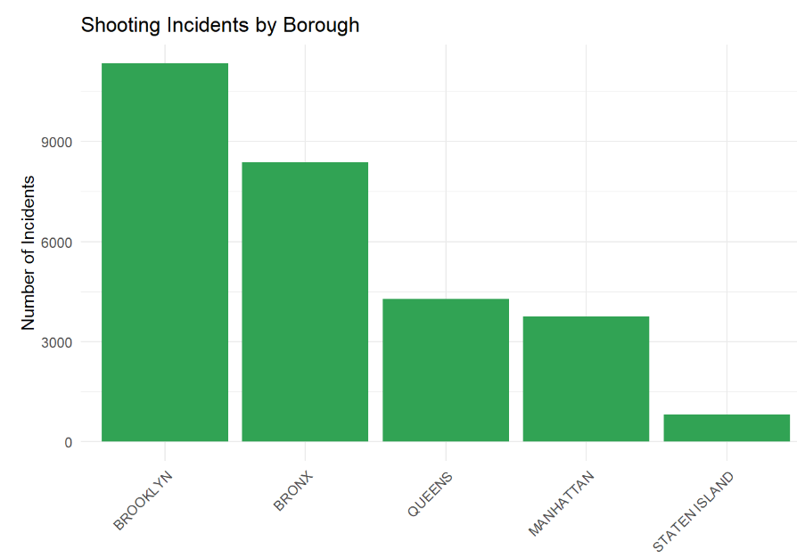
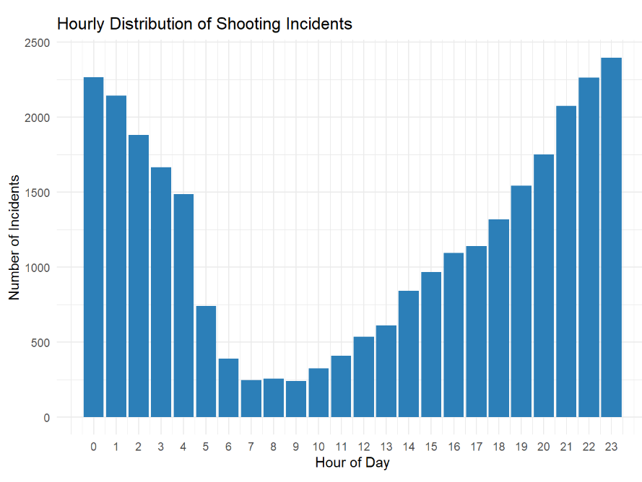
Total Incidents Breakdown
Geographical Distribution
Distribution of Shooting Incidents Across NYC Boroughs
Borough-wise Analysis
Brooklyn recorded the highest number of shooting incidents, standing out significantly.
Fatality Rates
The average fatality rate across the boroughs was approximately 21%.
Peak Hours
A notable 40% of the shootings occurred between
22:00 and 02:00,
indicating a critical timeframe.
Hourly Graphs
24- hour graphs displayed the density of incidents across different times of the day.

Slide 4
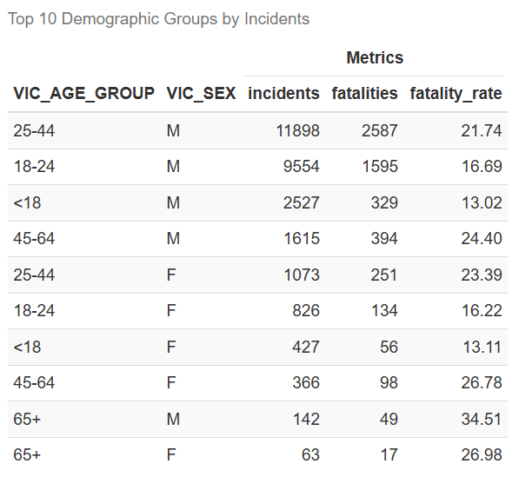
Demographic Impact
Age and Gender Analysis
Males aged 18- 44 years were the most affected group, with 11,898 incidents recorded.
Fatality Statistics
Within this group, 2,587 fatalities occurred, equating to a concerning rate of 21.74%.

Slide 5
Targeted Patrol Recommendations
Night Patrol Allocation
Resource Deployment
Enhanced night patrols are recommended during peak incident hours to curb the shootings.
It is recommended that resources be allocated to identified high-risk areas to improve the effectiveness of crime prevention.
Community Engagement
Engage community resources and stakeholders to address underlying factors contributing to crime.

Slide 6
Thanks

